Slide 1





Diabetes Classification Model using XLminer
Group 1: Anthony Santiago, Anthony Wu, Kyle Kumar,
Francisco Acosta Ugalde, Dennis Uy, Thanh Vo

Slide 2
Table of Contents
01
02
03
Classifications with KNN
Introduction/ Background
Data
Preprocessing
04
05
06
Logistic
Regression
Future works and Conclusion
Classifications with CART

Slide 3
Background Introduction/ Research #1:
“Long-Term Diabetes Risk Assessment”
https://ieeexplore.ieee.org/abstract/document/9491154
Age: is one of the most important risk factors for diabetes, as older people have a higher risk to get type 2 diabetes.
Obesity/High Body Mass Index (BMI): increased BMI, and consequently obesity, is a top risk factor for type 2 diabetes.
Gender: male/female
Ethnicity/Race: prevalence of diabetes is overall higher in the case of Hispanic/Latino Americans, African Americans, Native Americans, Asian-Americans, Pacific Islanders, and Alaska natives.
Smoking: smoking is associated with a higher risk of T2DM.

Slide 4
Background Introduction/ Research #2:
“5 Easy-to-miss Signs of Diabetes” https://www.keckmedicine.org/blog/5-easy-to-miss-signs-of-diabetes/
1. Fatigue
2. Thirst and increased urination
3. Weight loss and increased hunger
4. Tingling or numbness in the hands or feet
5. Blurry vision

Slide 5
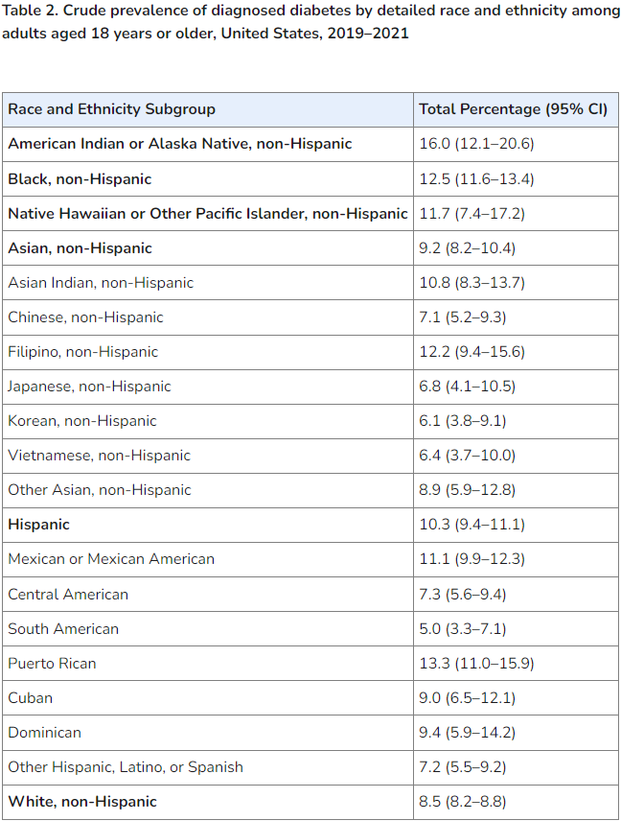
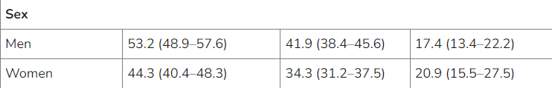
Background Introduction/ Research #3:
“National Diabetes Statistics Report” https://www.cdc.gov/diabetes/php/data-research/index.html#:~:text=Prevalence%20of%20prediabetes%20among%20adults&text=An%20estimated%2097.6%20million%20adults,A1C%20level%20(Table%204).
Prevalence of prediabetes among adults
Risk factors for diabetes-related complications

Slide 6
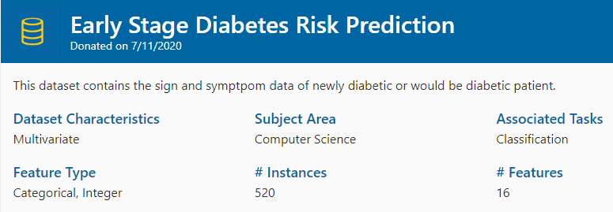
Introduction #1:
“Early Stage Diabetes Risk Prediction”
https://archive.ics.uci.edu/dataset/529/early+stage+diabetes+risk+prediction+dataset
This dataset has been collected using direct questionnaires from the patients of Sylhet Diabetes. Hospital in Sylhet, Bangladesh and approved by a doctor.
We have chosen a dataset that has a variety of contributing factors to predict diabetes.

Slide 7
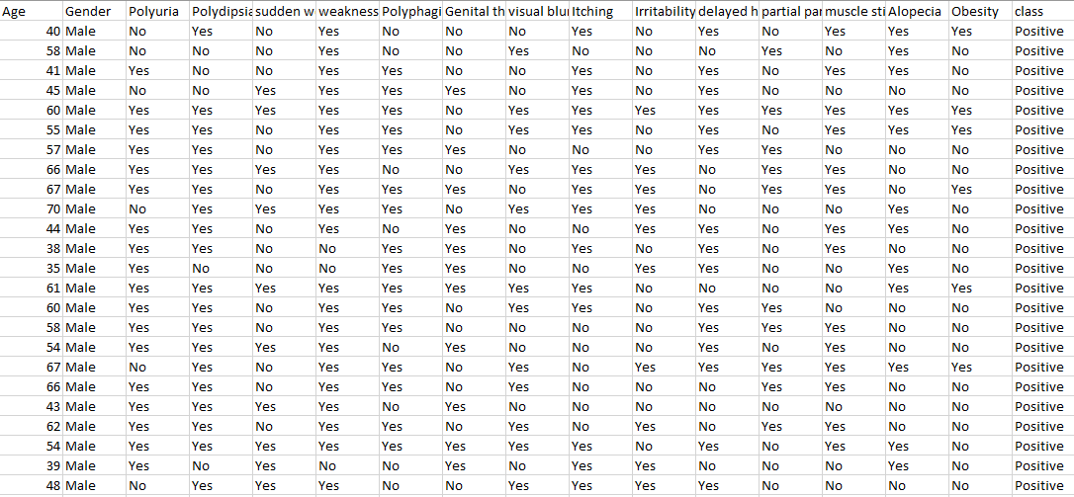
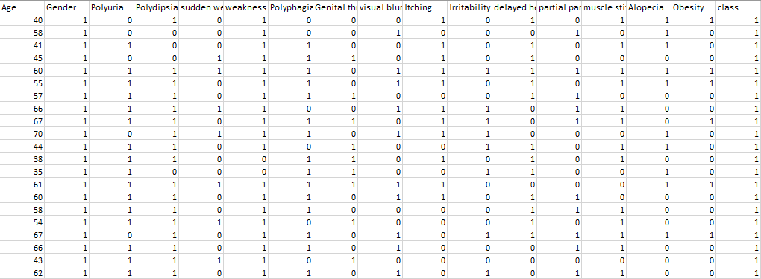
Introduction #2:
Data Preprocessing
Categorical > Numerical

Slide 8
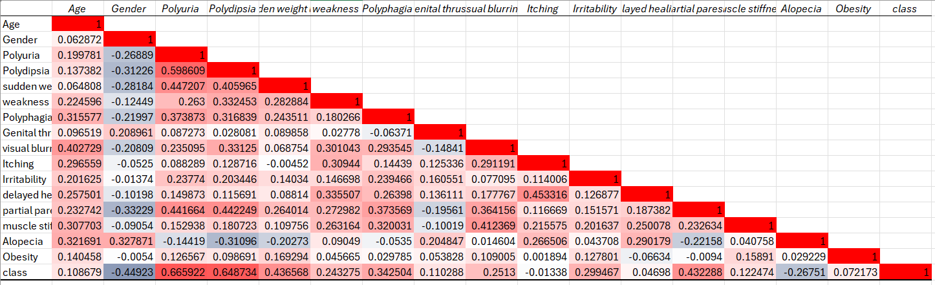
Introduction #3:
Heatmap of correlation table
Final line is the target variable (diabetes), so the correlation numbers showcase each independent variable is a correlation to the dependent variable

Slide 9
K Nearest Neighbors
The most important thing when deciding to do a kNN is the variables that are chosen.
We ran three different variable subsets to compare the results between and figure out which was the best.
We did kNN all variables, kNN with variables that had a correlation over 0.1, and kNN using the subset of variables chosen by Logistic Regression.

Slide 10
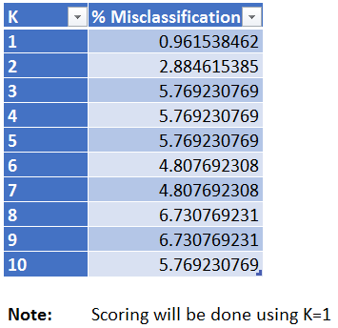
kNN All Variables
The first thing we did was search K, and curiously our lowest K values were 1 and 2, but since neither can be used we had to go with the next lowest odd number of K=7. This is a common trend in our next runs.
The data is of course standardized across all variable selections.

Slide 11
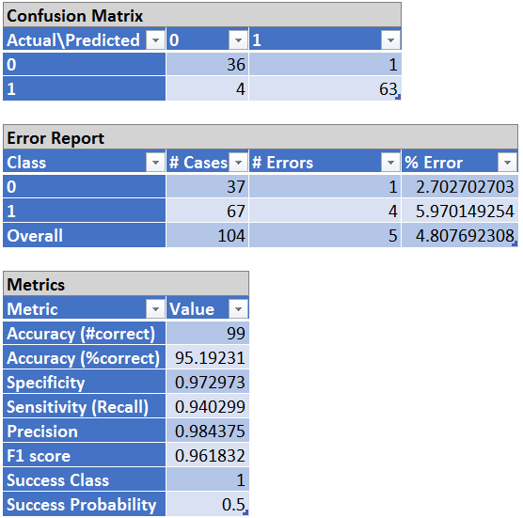
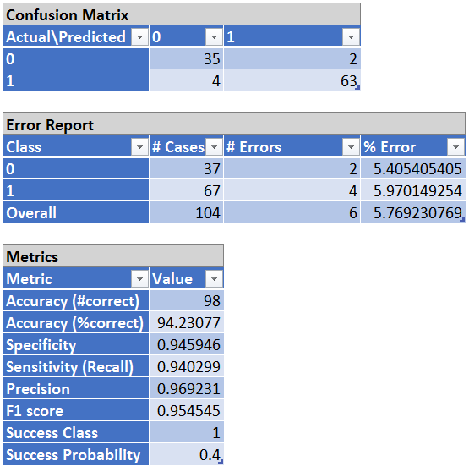
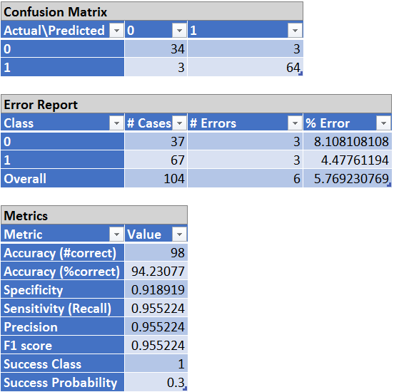
All Variables Cutoff Rates
Overall accuracy does not change much across cutoff rates.
If sensitivity is highly important, overall accuracy can be sacrificed to increase it slightly.

Slide 12
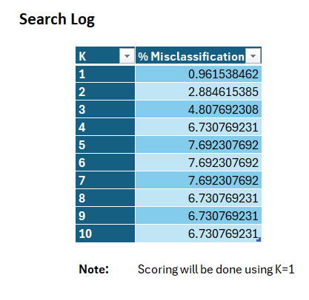
kNN Variables of High Correlation
Our second kNN that we ran was with variables of high correlation, meaning they were over 0.1 correlation with the outcome variable.
Three variables were removed as they were lower than 0.1, being itching, delayed healing, and obesity.
K was set to 3, being the lowest error rate that was not an even number nor equal to 1.

Slide 13
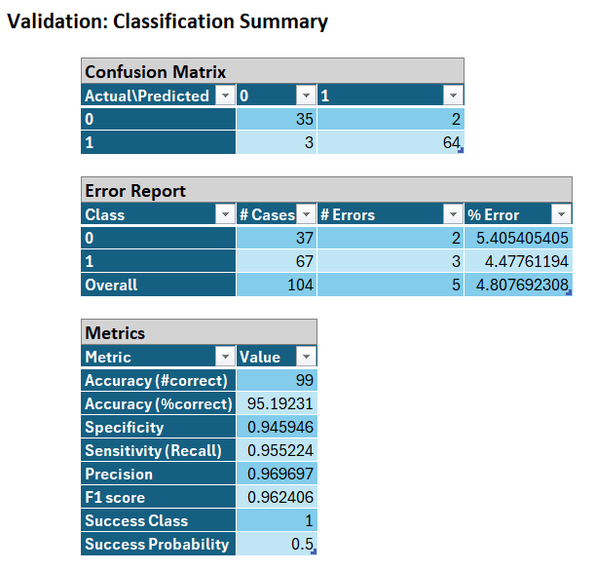
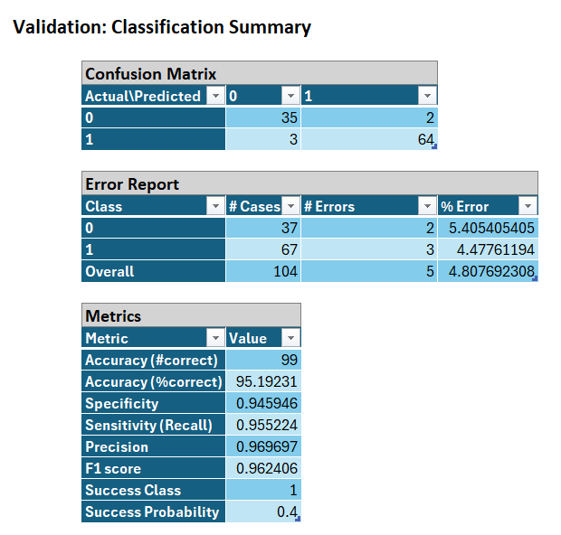
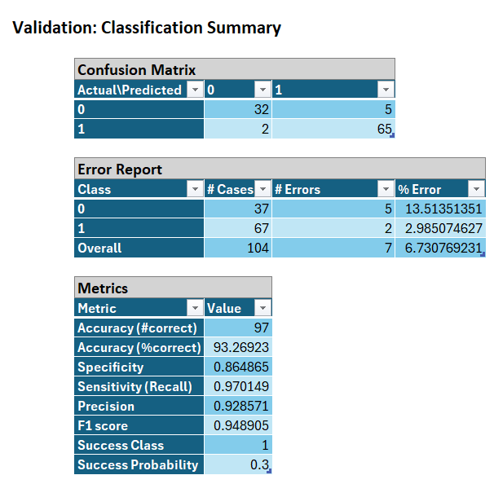
Correlated Variables Cutoff Rates
Overall accuracy is similar to All Variables
Once again if higher sensitivity is desired, lowering the cutoff rate can provide it at the cost of lower overall accuracy and specificity.

Slide 14

kNN Variables from Log Reg
The final kNN variable subset we used was running only the variables selected by the best Logistic Regression model.
This subset was Age, Gender, Polyuria, Polydipsia, Weakness, Polyphagia, Genital Thrush, Itching, Irritability, and Partial Paresis.
The k value we selected for this was 7, due to the recurring problem of 1 and 2 being the lowest error rate but unusable.

Slide 15
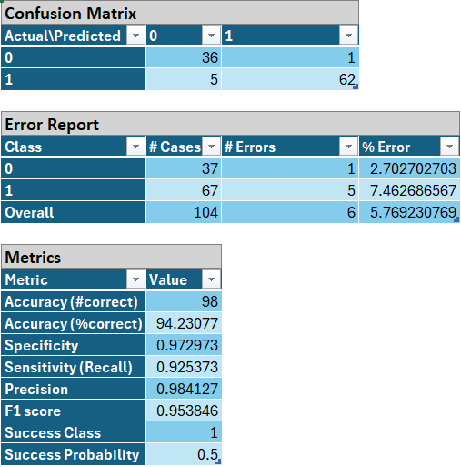
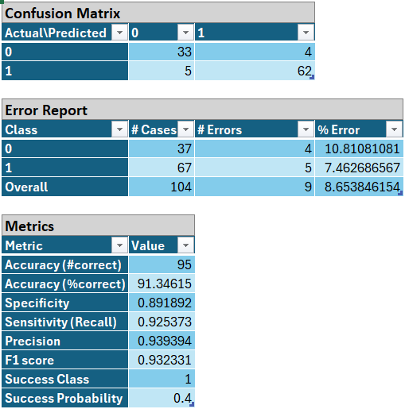
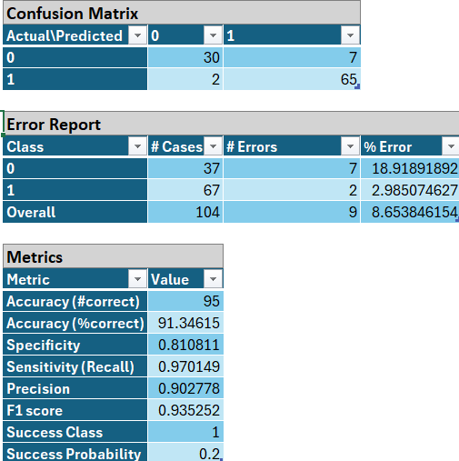
Log Reg Variables Cut Off Rates
Highest overall error rates of the three kNN’s that we ran.
Cutoff 0.4 and 0.3 are identical so I instead showcase 0.2, to show that if higher sensitivity is desired it is possible.

Slide 16
Best kNN Summary
Looking at all three choices there is a clear winner, which is running kNN with variables over 0.1 correlation.
These variables provide the lowest overall error rate of 4.8%, and if a lower cutoff is chosen the highest sensitivity of 97%.
Since diabetes is an important condition to catch, that high sensitivity is valuable.

Slide 17
CART - Summary
The CART model for diabetes prediction utilizes key symptoms and characteristics: polydipsia[excess thirst], gender, age, alopecia, delayed healing, muscle stiffness, irritability, obesity, and sudden weight loss) to classify patients
This process includes recursive partitioning, measuring the impurity to guide the splits, and pruning our data to optimize the performance
We would then end up with our sensitivity, specificity, and accuracy about the data.
Notes:
Polyuria: As the root node, polyuria is the single most important predictor in the tree.
Polydipsia: Appears prominently as a crucial follow-up predictor, especially in patients who already have polyuria.

Slide 18
CART - interpretation
Root Node:
Polyuria: This node serves as the root of the decision tree. It indicates that polyuria is the most significant initial predictor of whether a patient has diabetes. The splitting criterion is based on whether the patient has polyuria.
Top Nodes: Polyuria and polydipsia are at the top of the tree, indicating they are the most critical indicators of diabetes.
Sensitivity (True Positive Rate): 97.01%
This indicates that the model correctly identifies 97.01% of actual diabetic cases. A high sensitivity is crucial in medical diagnoses to ensure that most patients with the disease are correctly identified.
Specificity (True Negative Rate): 100%
This indicates that the model correctly identifies 100% of non-diabetic cases. High specificity ensures that healthy individuals are not falsely diagnosed with the disease.
Accuracy:
Considering the sensitivity and specificity(between all cutoffs), the model is highly accurate. The perfect specificity suggests that the model does not produce false positives, while the high sensitivity indicates very few false negatives. This balance is particularly important in medical applications where the cost of misdiagnosis can be significant.

Slide 19
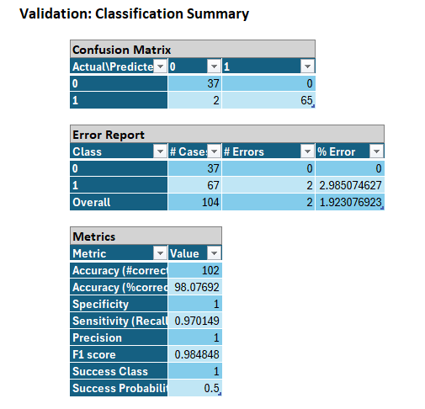
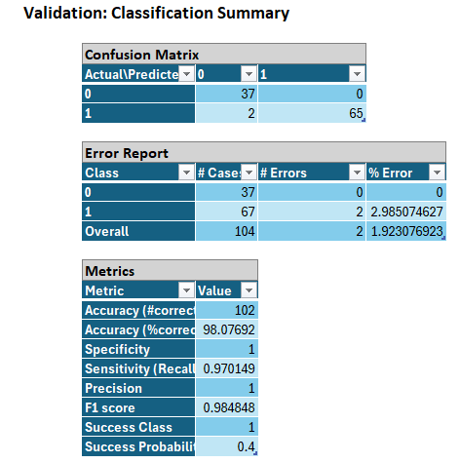
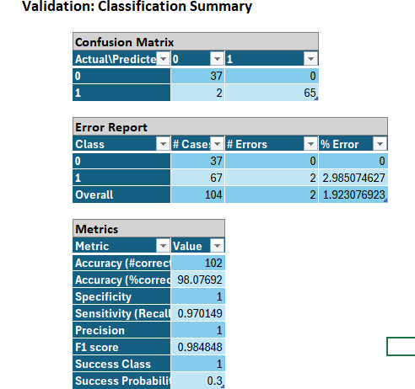
CART - Validation Score
Validation error only got 1.9% wrong, data is performing good because of low error rate

Slide 20
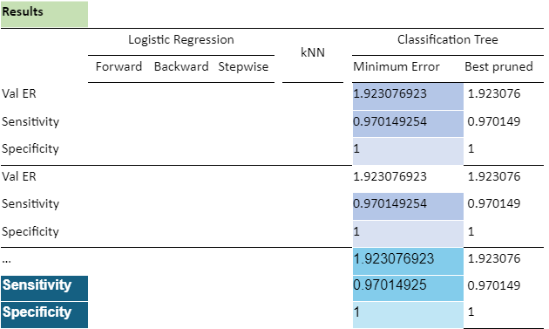
CART - chart
Val ER: 1.92%, indicating a 1.92% (low)error rate
Sensitivity: 97% accuracy
Specificity: 100% accuracy.

Slide 21
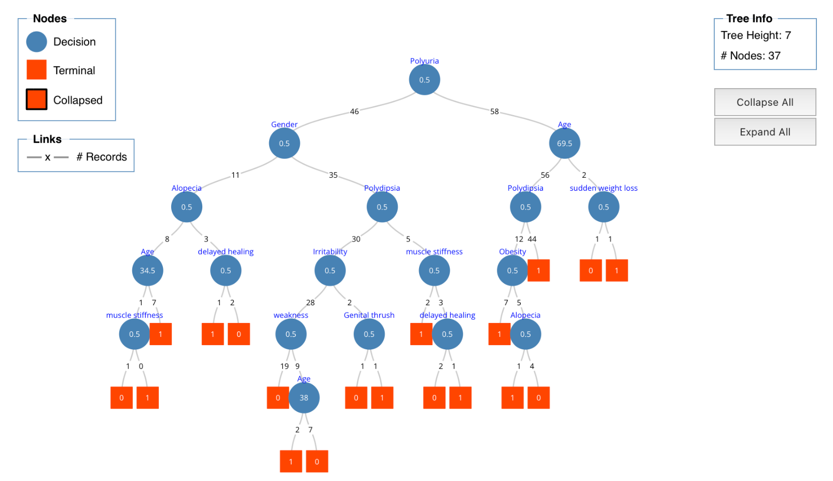
Classification Tree - minimum error
Cut-off: 0.3
Cut-off: 0.4
Cut-off: 0.5

Slide 22
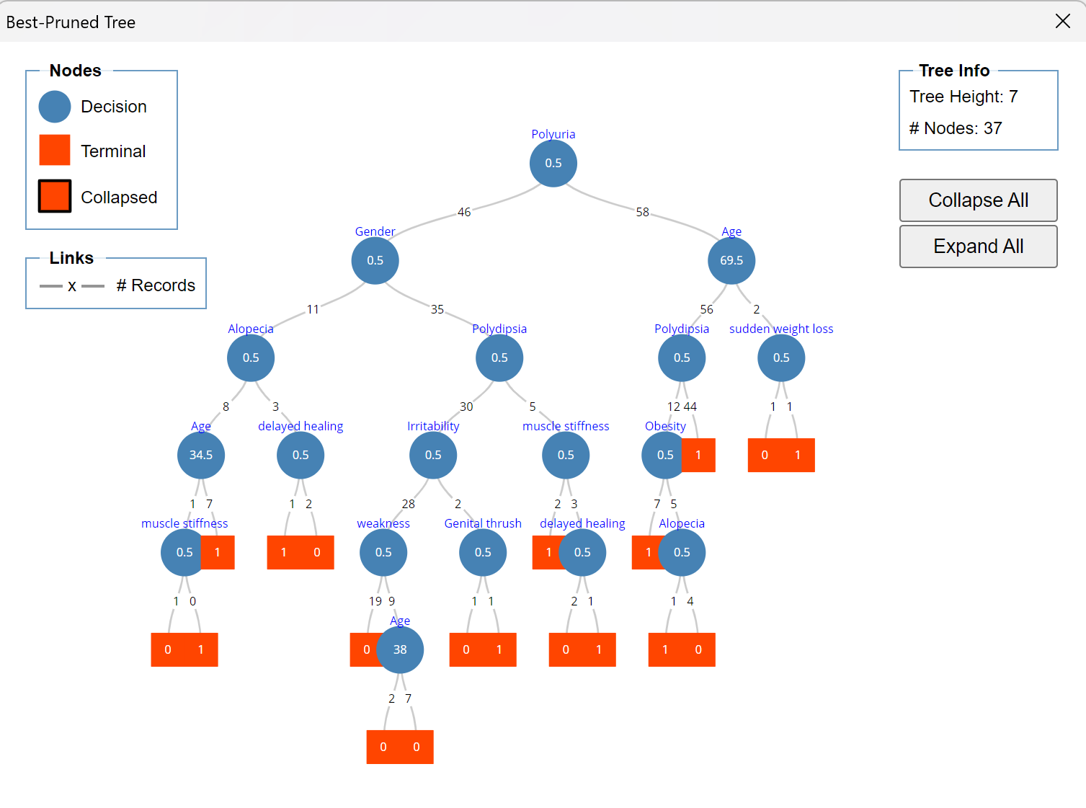
Classification Tree - best pruned tree
Cut-off: 0.5
Cut-off: 0.4
Cut-off: 0.3
Due to our data set sizes, it is not surprising that the best prune tree and minimum error tree are the same.

Slide 23
Logistic Regression Forward Selection
In forward selection, we start with no variables in the model. Variables are added one at a time based on a chosen criterion to see which variable improves the model the most. This process continues until no additional variables improve the model significantly.
We first used feature selection under logistic regression with all the variables for forward selection to find the best subset
We ran the data once again with the best subset and at different cutoff rates from 0.5 to 0.1.
Notably in our data, an insignificant variable such as sudden weight loss with a high p-value remained In forward selection, "sudden weight loss" might have been among the first variables added due to its high initial significance, particularly due to its correlations with Polyuria and Polydipsia

Slide 24
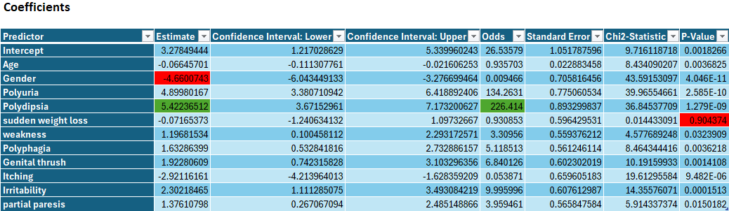
Logistic Regression (Forward Selection)
0.4 cutoff rate

Slide 25
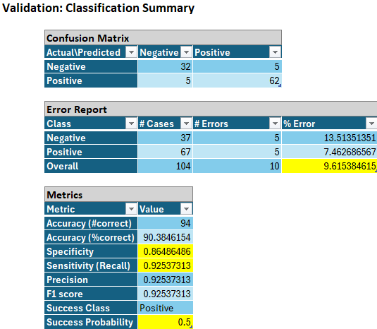
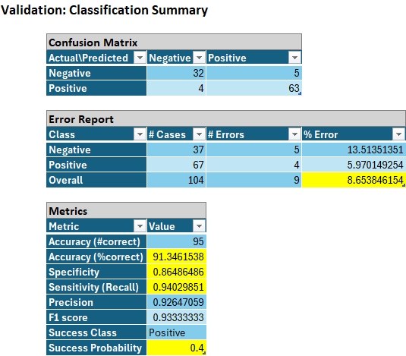

Logistic Regression Forward Selection cutoff comparisons
0.4 cutoff rate gives the lowest error rate, best accuracy, higher specificity and sensitivity.

Slide 26
Logistic Regression Backwards Selection
In backward selection, we start with all candidate variables included in the model. Variables are then removed one at a time based on a chosen criterion, removing the least significant variable at each step. This process continues until only significant variables remain.
We first used feature selection under logistic regression with all the variables for backwards selection to find the best subset
We ran the data once again with the best subset and at different cutoff rates from 0.5 to 0.1.

Slide 27
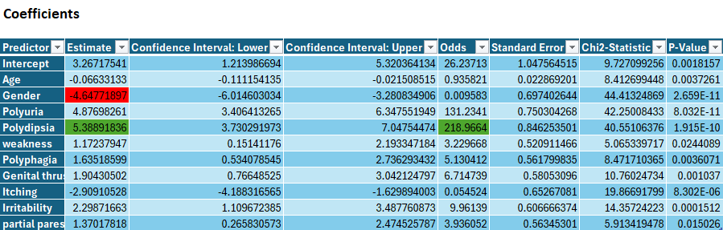
Logistic Regression (Backward Selection)
0.4 cutoff rate
0.4 cutoff rate

Slide 28
Logistic Regression Backwards Selection cutoff comparisons
0.4 cutoff rate gives the lowest error rate, best accuracy, higher specificity and sensitivity.

Slide 29
Logistic Regression Stepwise Selection
Stepwise selection is a combination of forward and backward selection. It adds and removes variables iteratively to find the best subset. At each step, it evaluates the addition of variables like forward selection and the removal of variables like backward selection.
We first used feature selection under logistic regression with all the variables for Stepwise selection to find the best subset
We ran the data once again with the best subset and at different cutoff rates from 0.5 to 0.1.

Slide 30
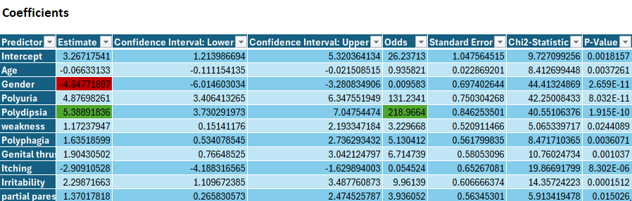
Logistic Regression (Stepwise Selection)
0.4 cutoff rate

Slide 31
Logistic Regression Stepwise Selection cutoff comparisons
0.4 cutoff rate gives the lowest error rate, best accuracy, higher specificity and sensitivity.

Slide 32
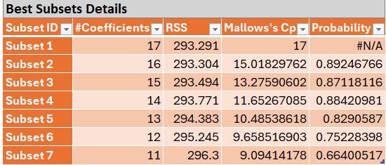
Logistic Regression Best Subset
Backward selection or Stepwise Selection with a cutoff rate of 0.4 is shown to be the best fit
Forward selection included a variable of sudden weight loss, it has a high p value of 0.9
Subset 7 predictors: Age, Gender, Polyuria, Polydipsia, weakness, polyphagia, gential thrush, itching, irritability, partial paresis.

Slide 33
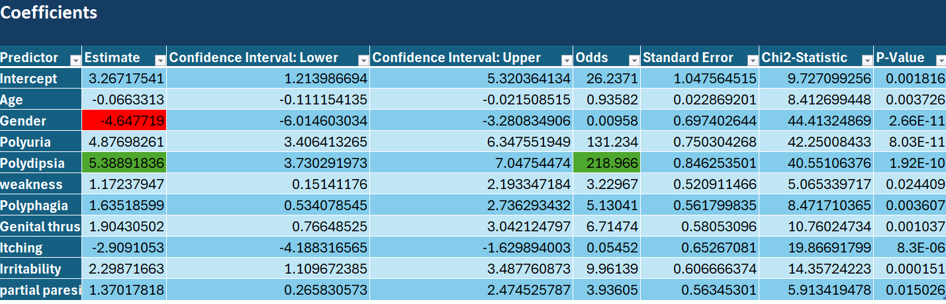
Logistic Regression-Odds Ratio
The estimate for polydipsia indicates that experiencing excessive thirst increases the probability of having diabetes by %5.39.
The Gender variable is a discrepancy. Our model points to females having higher risks to diabetes where other models point to males.
The odds ratio is 218.9664, meaning individuals with polydipsia are approximately 218.9664 times more likely to have diabetes compared to those without this symptom, assuming all other factors are held constant.

Slide 34
Best Overall Classification Method
The best method that we found was CART, with highest overall accuracy and the highest sensitivity.
Changing the cutoff on kNN would grant it the same sensitivity but with higher overall error rate.
CART
2. kNN
3. Logistic

Slide 35
Future Research
Background research: men vs women
Background research: ethnicity vs diabetes predictors
Logistic Regression/ CART: polydipsia (excessive thirst), polyuria (Excessive urination volume) are at the top, indicating they are the most critical indicators of diabetes

Slide 36
Citations
https://ieeexplore.ieee.org/abstract/document/9491154
https://www.keckmedicine.org/blog/5-easy-to-miss-signs-of-diabetes/
https://www.cdc.gov/diabetes/php/data-research/index.html#:~:text=Prevalence%20of%20prediabetes%20among%20adults&text=An%20estimated%2097.6%20million%20adults,A1C%20level%20(Table%204).

